Slide 1
Architrave Design
Jason Cameron, Alison Hall, Michael Rousselle

Slide 2
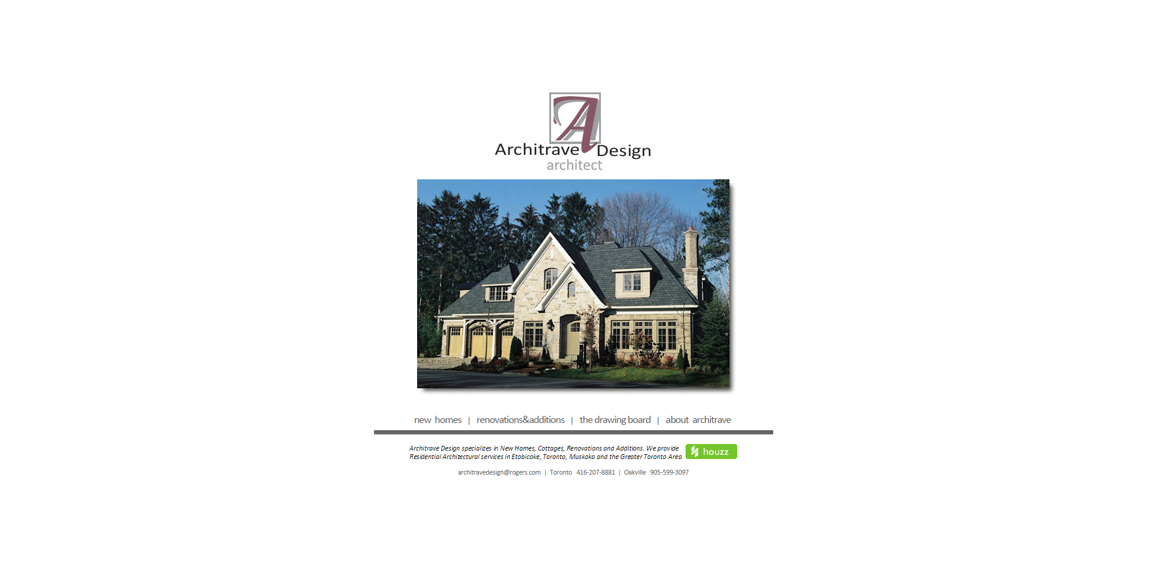
Previous website: home page

Slide 3
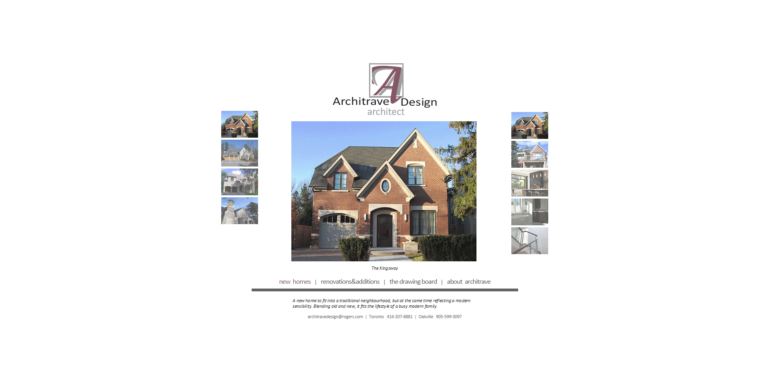
Previous website: gallery

Slide 4
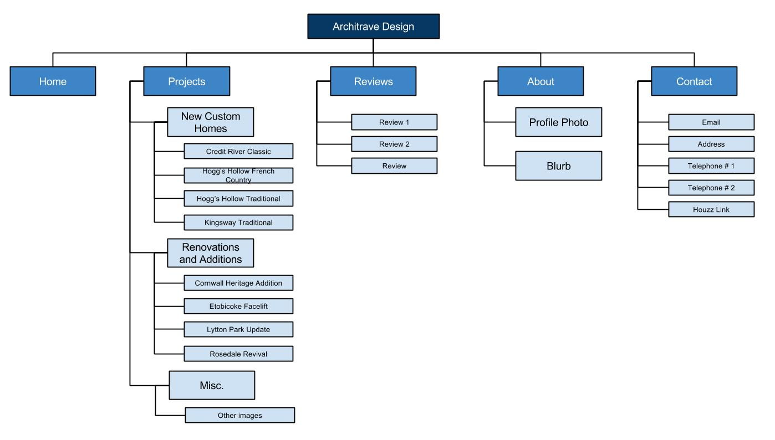
Site Map

Slide 5
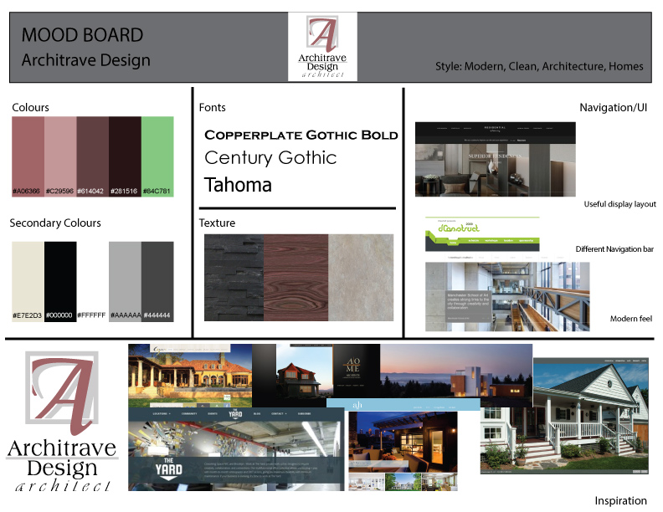
Mood Board

Slide 6
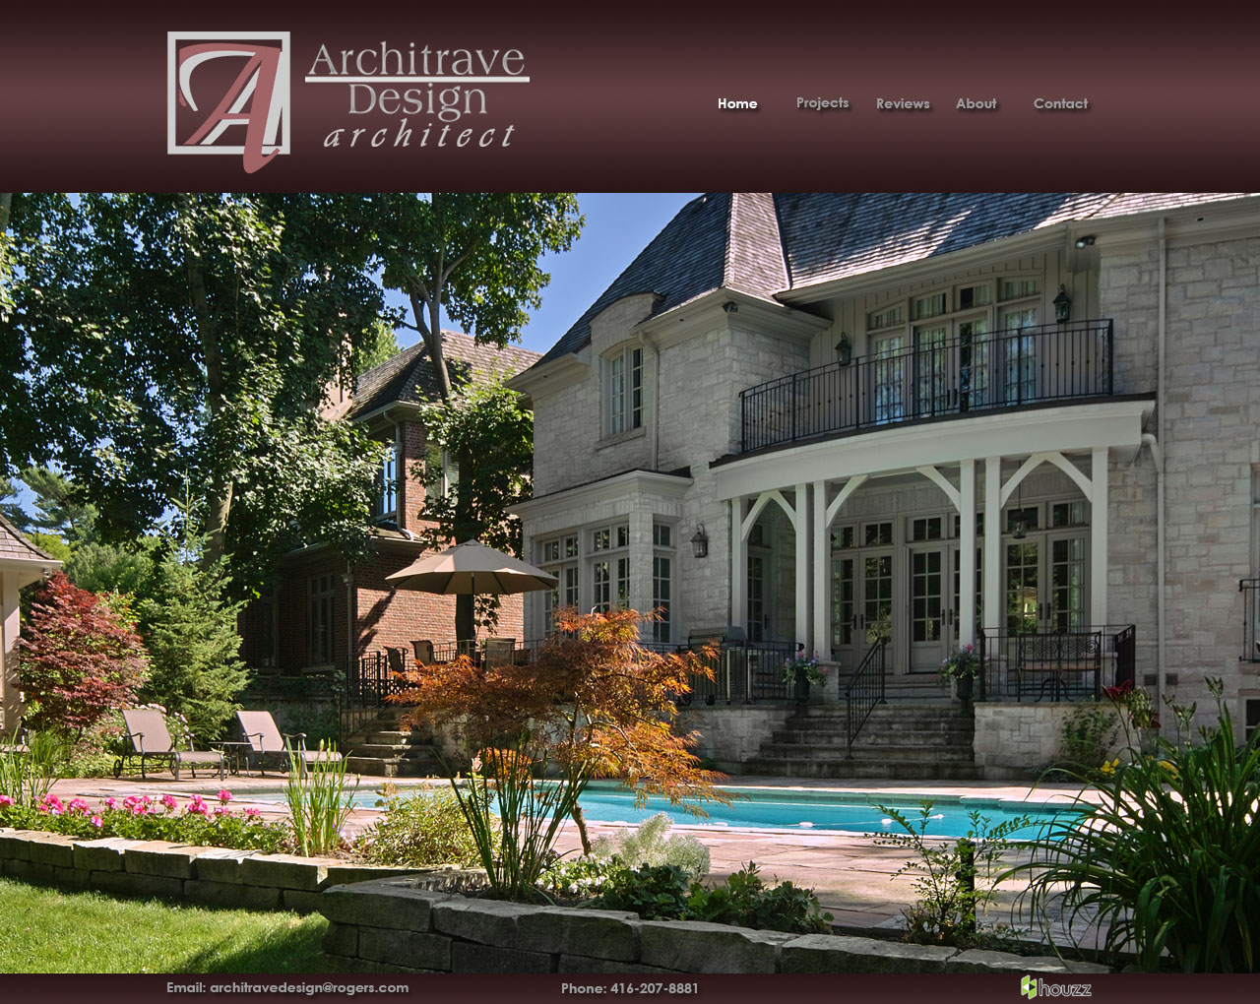
Layout: Home Page

Slide 7
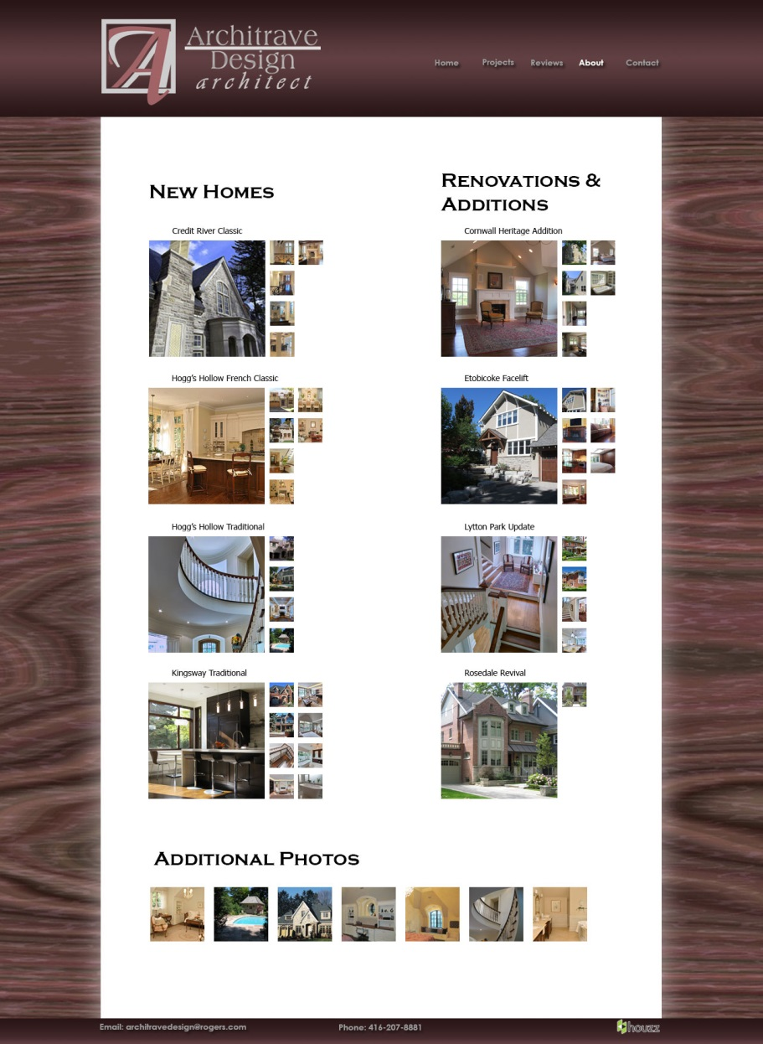
Layout: Projects Page

Slide 8
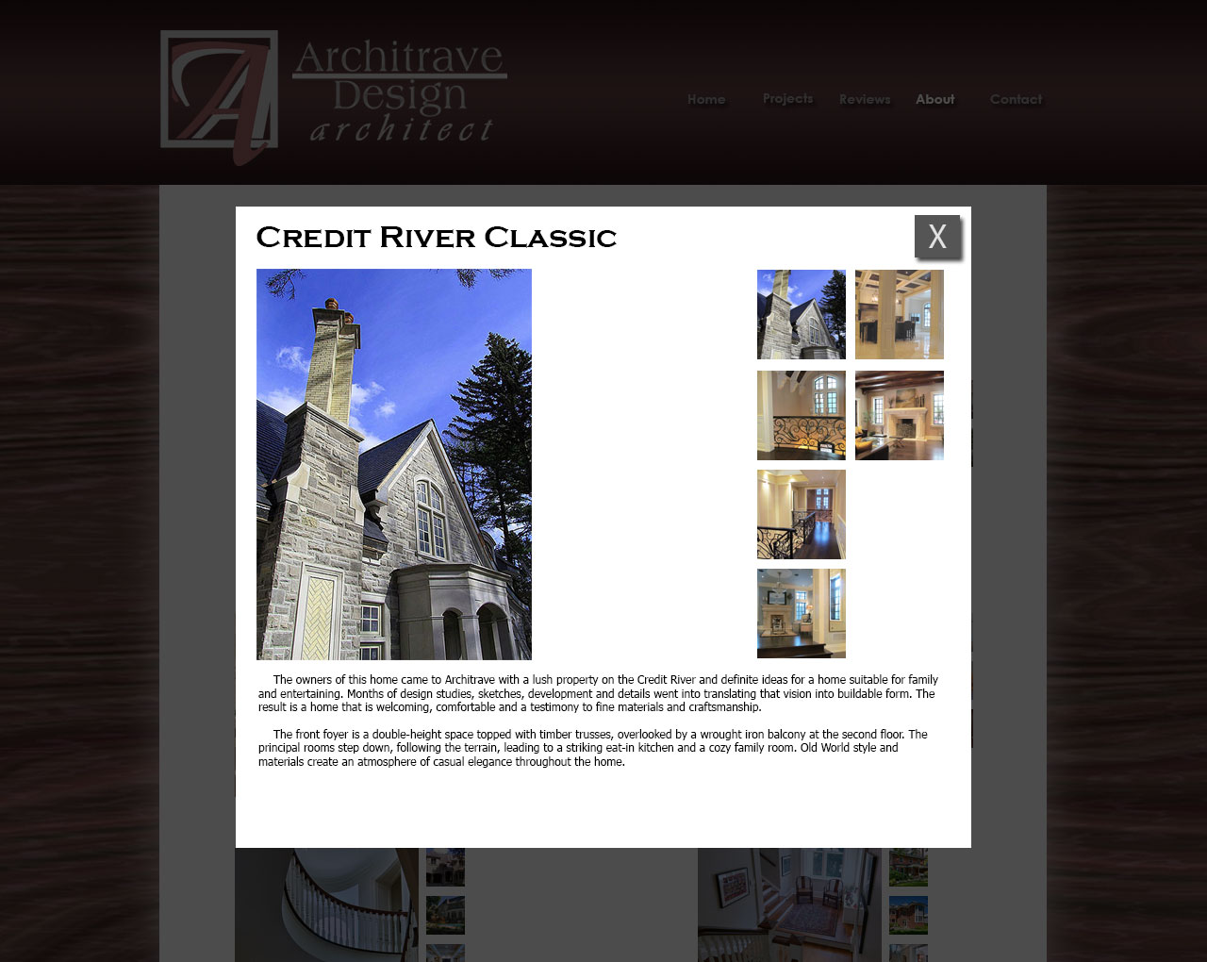
Layout: Projects Page, Modal Window

Slide 9
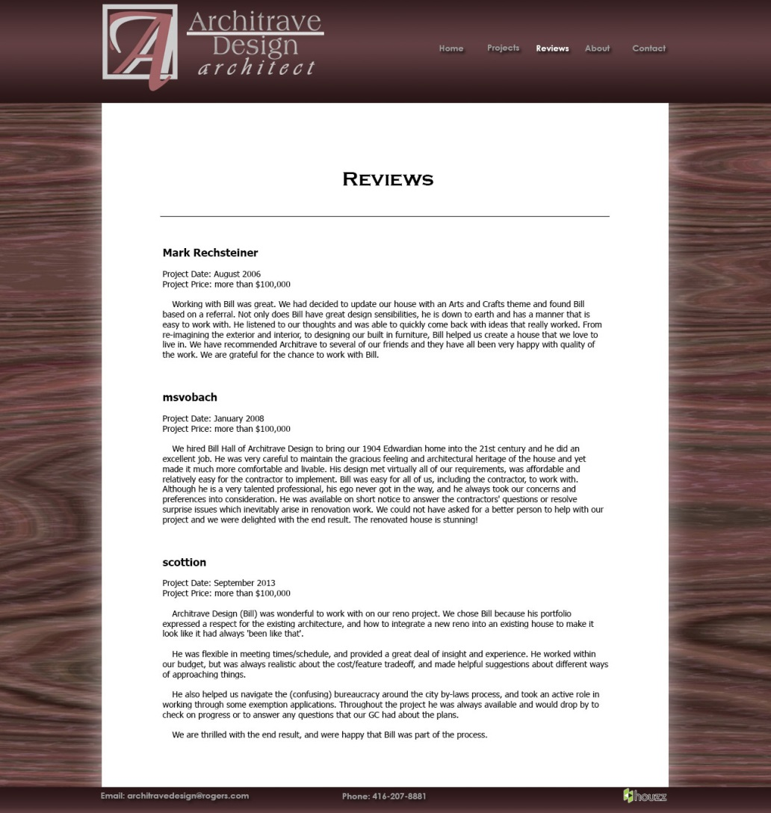
Layout: Reviews Page

Slide 10
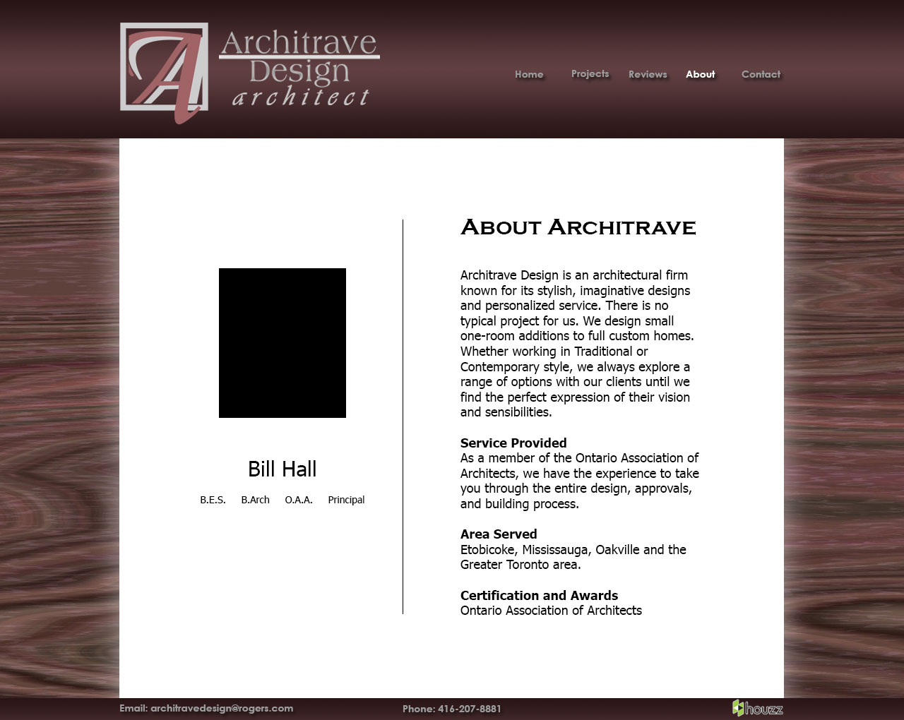
Layout: About Page

Slide 11
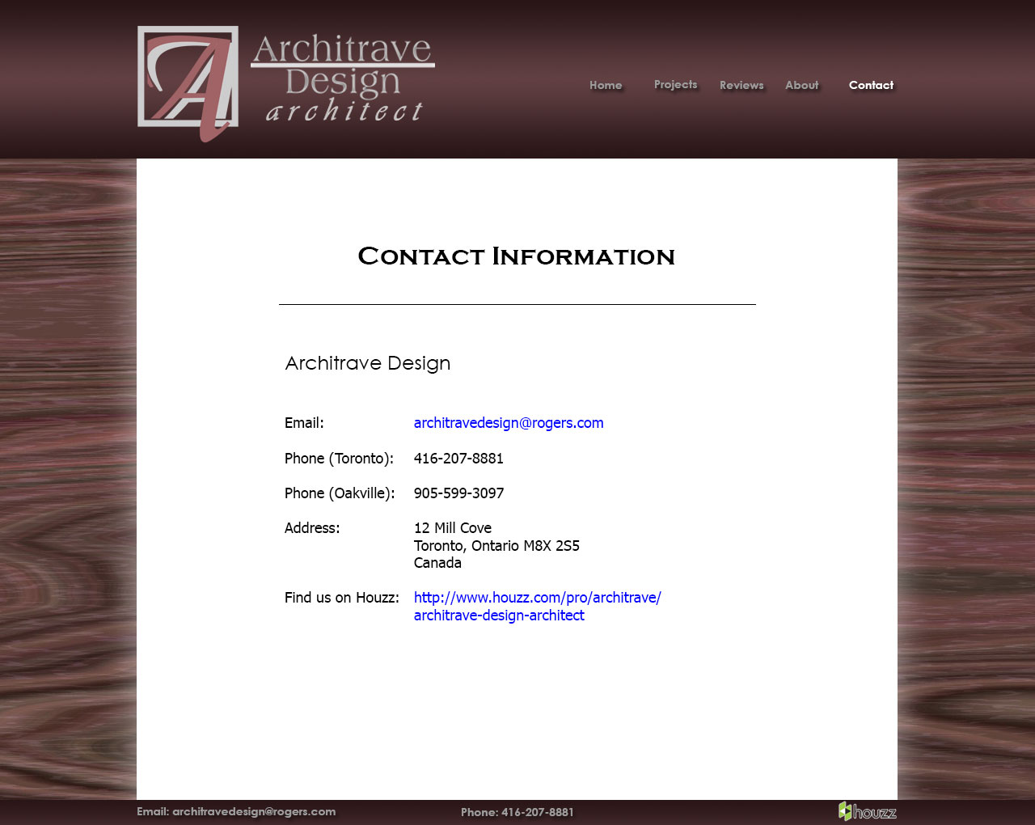
Layout: Contact Page

Slide 12
Website

Slide 13



Business Cards

Slide 14
Conclusion
Thanks for listening!

